Slide 1
Proposed Active-Site Transplant Mutations (Mb and Ma)
Mb-Sites | 266 | 270 | 271 | 274 | 311 | 313 | 366 | 382
Mb-PylRS-WT | L | L | Y | L | N | C | A | W
Mb-TFAcKRS1 | M | I | Y | A | N | F | A | W
Mb-AcKRS1 | V | I | F | A | N | F | A | W
Mb-AcKRS2 | L | I | L | A | N | F | A | W
Mb-AcK3RS | M | I | F | A | N | F | V | W
Ch-AcK3RS* | M | I | F | A | N | F | V | W
Ma-Sites | 121 | 125 | 126 | 129 | 166 | 168 | 223 | 239
Ma Library site | L | L | Y | M | N | V | A | W
AST | M | I | F | A | N | F | A | W

Slide 2
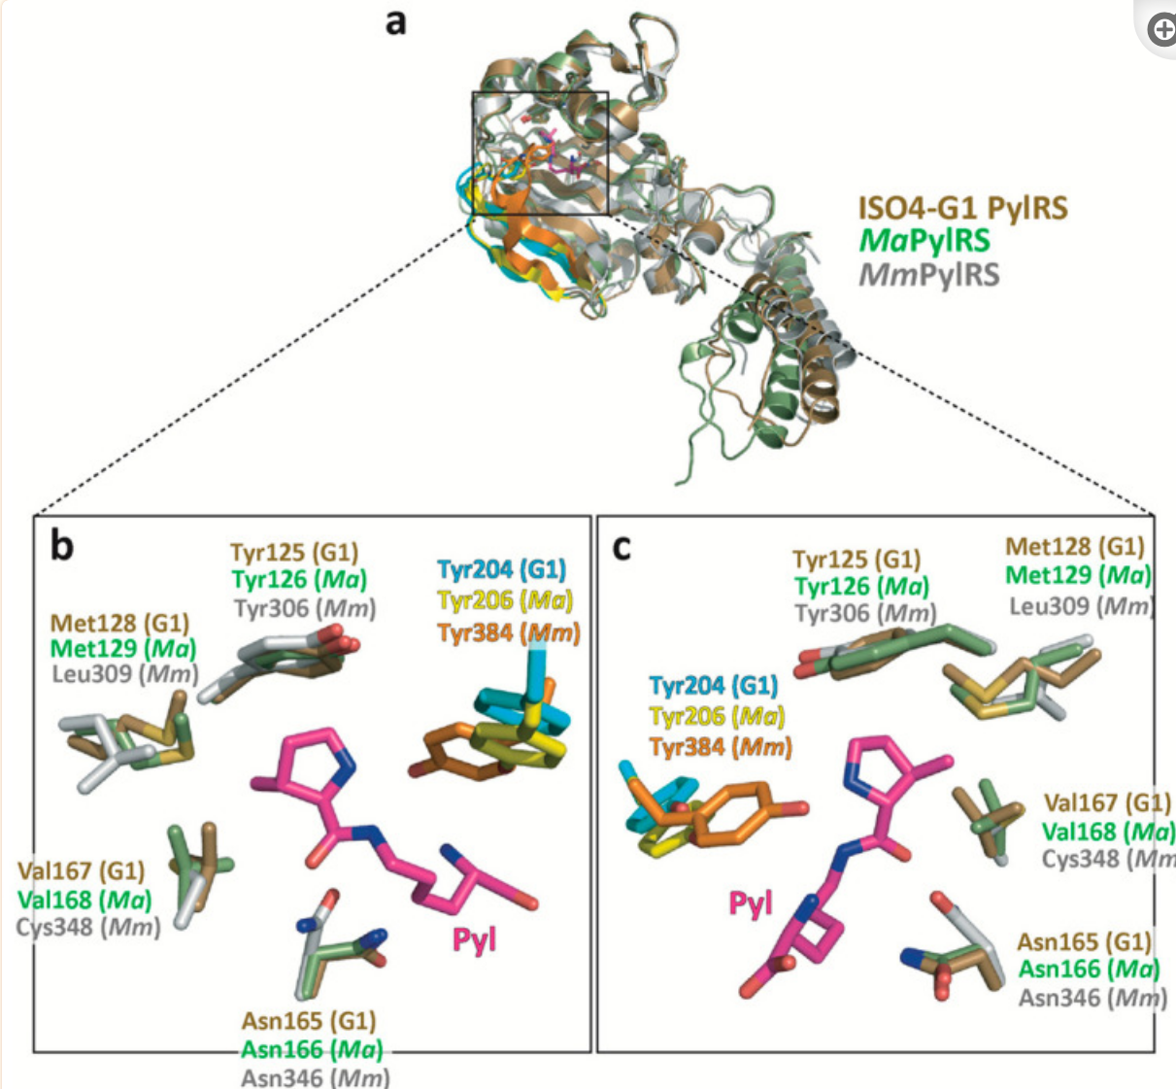
Proposed Active-Site Transplant Mutations (G1PylRS,Ma,Mm)
1. methanogenic archaeon ISO4-G1 (ISO4-G1 PylRS) is highly similar to MaPylRS with 64% sequence identity.
2. ISO4-G1 PylRS and MaPylRS both share around 38% sequence identity with M. mazei PylRSc
SITES | 121 | 124 | 125 | 128 | 165 | 167 | 204 | 227 | 237
ISO4G1-WT | A | L | Y | M | N | A | Y | L | W
pRSF-G1TFACKRS* | A | I | L | M | N | A | W | W | C
SITES | 122 | 125 | 126 | 129 | 166 | 168 | 206 | 229 | 239
MaPylRS-WT | A | L | Y | M | N | V | Y | L | W
Proposed AST | A | I | L | M | N | A | W | W | C
CITATION: Yanagisawa T, Seki E, Tanabe H, Fujii Y, Sakamoto K, Yokoyama S. Crystal Structure of Pyrrolysyl-tRNA Synthetase from a Methanogenic Archaeon ISO4-G1 and Its Structure-Based Engineering for Highly-Productive Cell-Free Genetic Code Expansion with Non-Canonical Amino Acids. Int J Mol Sci. 2023 Mar 26;24(7):6256. doi: 10.3390/ijms24076256. PMID: 37047230; PMCID: PMC10094482.

Slide 3
Summary of engineered AcK PylRSs
Mm-WT | L301 | A302 | L305 | Y306 | L309 | N346 | C348 | Y384 | V401 | W417
Mb-WT | L266 | A267 | L270 | Y271 | L274 | N311 | C313 | Y349 | V366 | W382
Ma-WT | L121 | A122 | L125 (5/6)* | Y126 (6) | M129 (6) | N166 (5/6) | V168 (5/6) | Y206 | A223 (5) | W239 (5/6)
ISO4-G1 WT | H120 | A121 | L124 | Y125 | M128 | N165 | V167 | Y204 | A221 | W237
Mb-AcKRS-1 ¹ | V | A | I | F | A | N | F | Y | V | W
Mb-AcKRS-2 ¹ | L | A | I | L | A | N | F | Y | V | W
Mb-AcKRS-3 ² | M | A | I | F | A | N | F | Y | V | W
Mm-AcKRS1 ³ | M | A | L | L | A | N | F | Y | V | W
Mm-AcKRS2 ³ | M | A | L | L | L | N | S | Y | V | W
Mm-AcLysRS ⁴ | L | A | I | F | A | N | F | Y | V | W
Ch-AcK3RS ⁷ | M | A | I | F | A | N | F | Y | V | W
Mb-TFAcKRS ⁵ | M | A | I | Y | A | N | F | Y | V | W
ISO-G4- TFAKRS ⁶ | H | A | I | L | M | N | A | W | C | W
Wild-type
PylRSs
* 5/6 indicates whether that residue is mutagenized in our 5- or 6-site Ma libraries
AST to Malvus RS was not functional for AcK (J Mol Biol. 2022 Apr 30;434(8):167453. doi: 10.1016/j.jmb.2022.167453.)
AcK
PylRSs
Also permissive for TfAcK (ACS Chem. Biol. 2022, 17, 5, 1022–1029 https://doi.org/10.1021/acschembio.2c00016 )
Also includes: V31I, T56P, H62Y, A100E (IPYE)
TfAcK
PylRSs
# times mutated:
6/9
0/9
7/9
8/9
7/9
0/9
9/9
1/9
1/9
0/9
(Residues in italics are mutated from WT)
¹ H Neumann, SY Peak-Chew, JW Chin, Genetically encoding N(^{ε})-acetyllysine in recombinant proteins. Nat Chem Biol 4, 232–234 (2008).
² Neumann H, Hancock SM, Buning R, Routh A, Chapman L, Somers J, Owen-Hughes T, van Noort J, Rhodes D, Chin JW. Mol Cell. 2009 Oct 9;36(1):153-63. doi: 10.1016/j.molcel.2009.07.027.
³ Umehara Takuya, Kim Jihyo, Lee Sangsik, Guo Li-Tao, Söll Dieter and Park Hee-Sung(2012), FEBS Letters, 586, doi: 10.1016/j.febslet.2012.01.029
⁴ T Mukai, et al., Adding l-lysine derivatives to the genetic code of mammalian cells with engineered pyrrolysyl-tRNA synthetases. Biochem Biophys Res Commun 371, 818–822 (2008).
⁵ Feng Zhang, Qing Zhou, Guiwen Yang, Liguo An, Fahui Li and Jiangyun Wang. Chem. Commun., 2018,54, 3879-3882
⁶ Orton HW, Qianzhu H, Abdelkader EH, Habel EI, Tan YJ, Frkic RL, Jackson CJ, Huber T, Otting G. J Am Chem Soc. 2021 Nov 15. doi: 10.1021/jacs.1c10104
⁷ Bryson, D., Fan, C., Guo, LT. et al. Continuous directed evolution of aminoacyl-tRNA synthetases. Nat Chem Biol 13, 1253–1260 (2017).

Slide 4
Site | WT | AA 1 | AA 2 | AA 3 | Primer Bases | Combination | AA Variants
121 | L [CTC] | L [CTG] | M[ATG] | H[CAC] | MWS | 2³ | NKIMHQLL
*122 | A[GCC] | - | - | - | - | - | -
125 | L[CTG] | I[ATT] | L[CTT] | - | MTA | 2¹ | IL
126 | Y[TAC] | L[CTT] | F[TTT] | Y[TAT] | TWM | 2² | (Stop)YLF
129 | M[ATG] | A[GCG] | L[CTG] | - | VYG | 3*2 | TMPLAV
166 | N[AAT] | - | - | - | - | - | -
168 | V[GTG] | F[TTT] | S[TCT] | A[GCT] | KYC | 2² | AVSF
206 | Y[TAC] | Y[TAC] | W[TGG] | - | TRS | 2² | (TAG)YCW
223 | A[GCC] | V[GTT] | C[TGT] | - | KBC | 2*3 | AGVSCF
239 | W[TGG] | - | - | - | - | - | -
Total |  |  |  |  |  | 2¹²*3²=36864

Slide 5
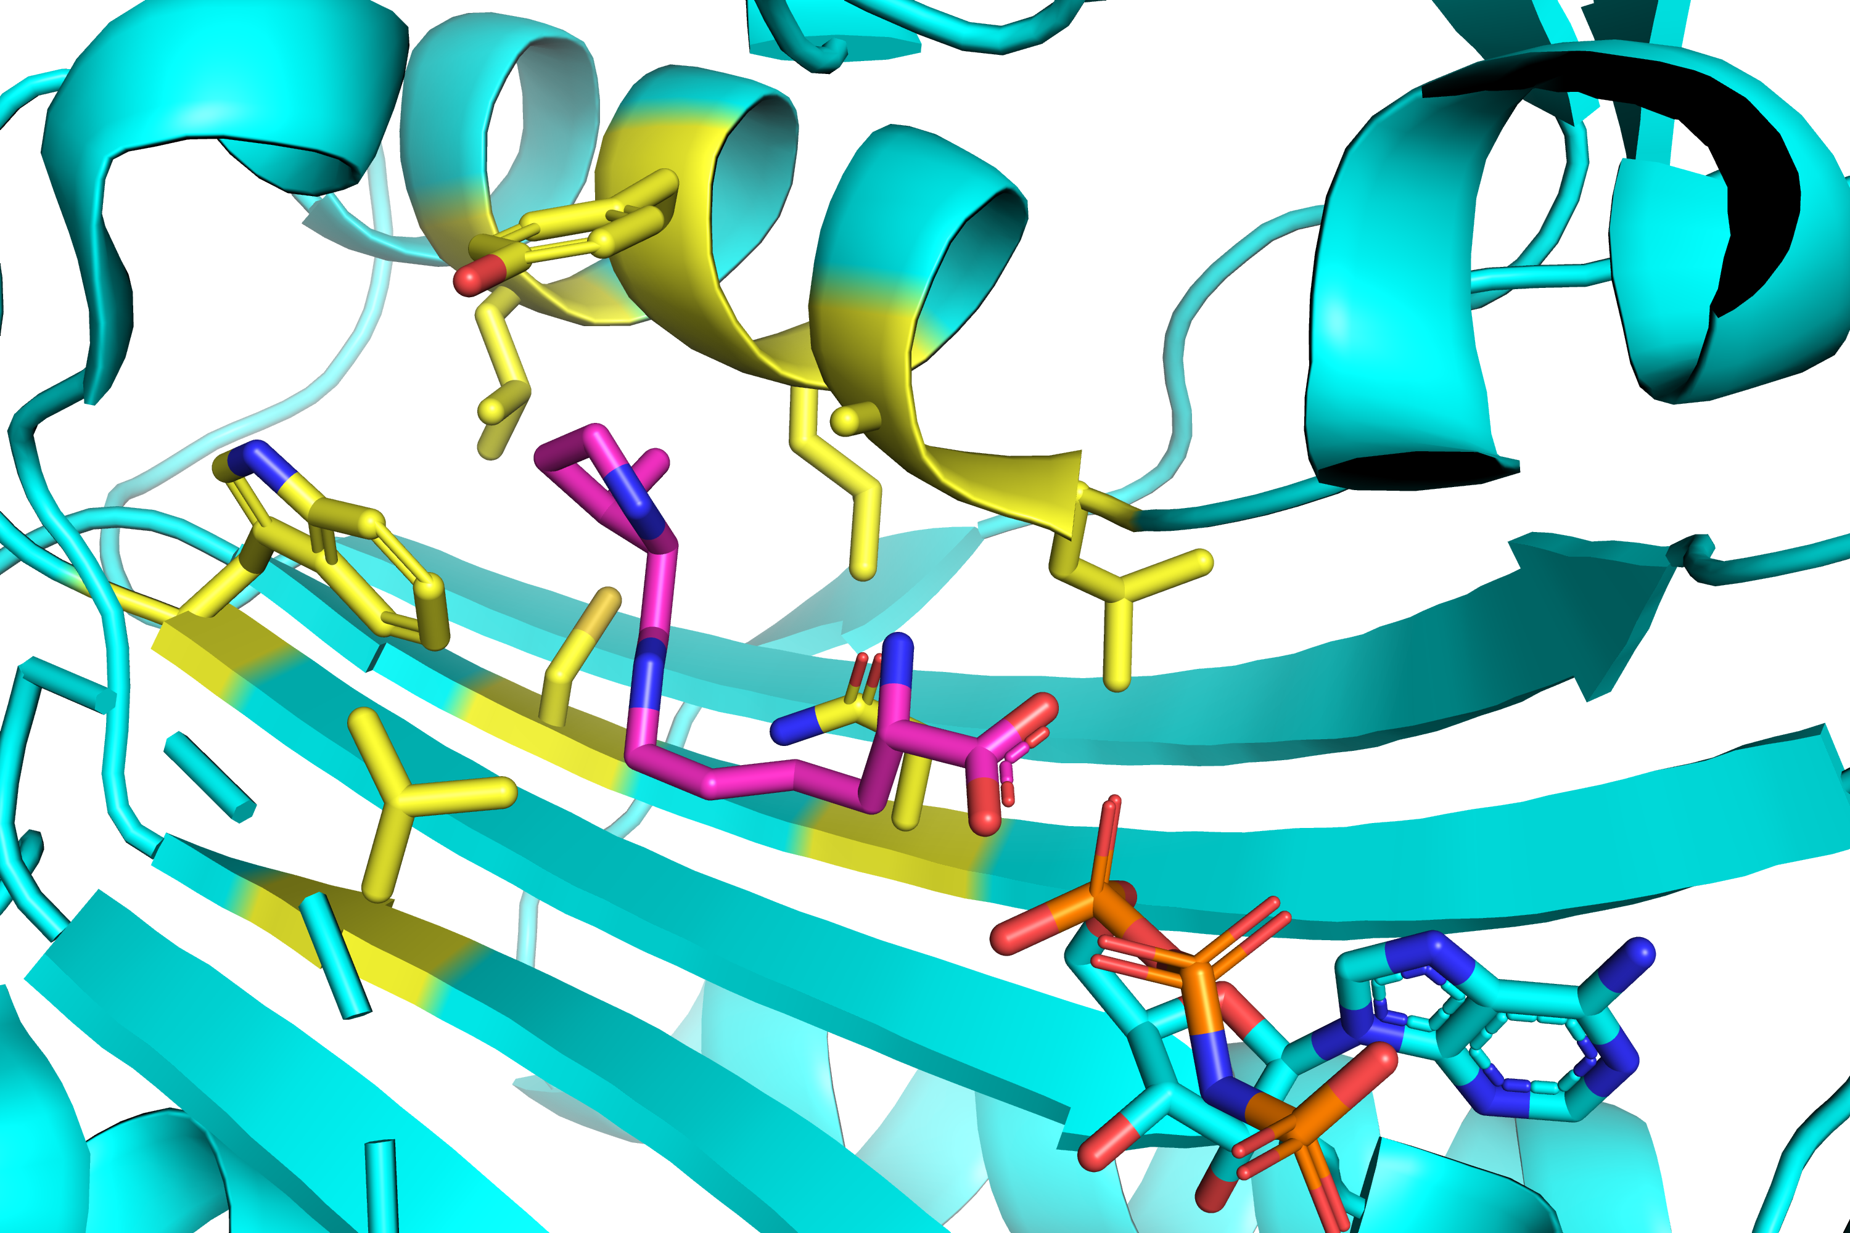
M. mazei structure labeled with M. alvus numbering
Y126
M129
A122
W239
L125
V168
L121
N266
A223

Slide 6
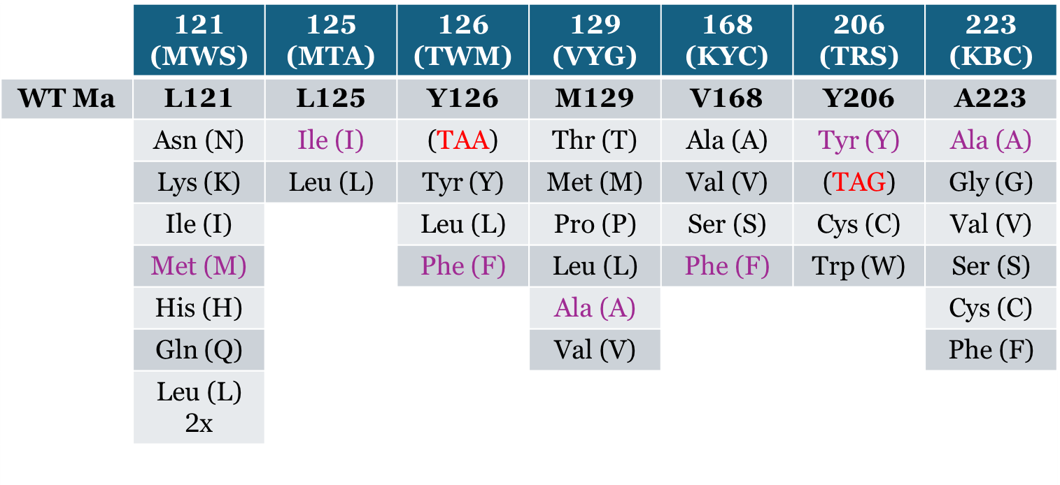
Current efforts
Constructed a focused library of Ma-RS variants based on active site mutations found in previously published Mb and Mm synthetases known to encode acetyllysine ^{[1] [3-8]}.
Alignment of the active site residues within these systems and the engineering of corresponding mutations in the Ma-RS active site led to the generation of a 36,864-member library designed for acetyllysine encoding

